Slide 1
COLOR SPACES
Prepared by: Yusuf KUVVETLİ 2015556002 Metin YORĞUN 2015556070

Slide 2
WHAT İS COLOR?
☆ Color is the aspect of things that is caused by differing qualities of light being reflected or emitted by them.
☆ A color can be pure,have a lightness/darkness and have a intensity.

Slide 3
WHAT İS COLOR SPACE?

Slide 4
overview
A range of colors can be created by the primary colors of pigment and these colors then define a specific color space. Color space, also known as the color model (or color system), is an abstract mathematical model which simply describes the range of colors as tuples of numbers, typically as 3 or 4 values or color components (e.g. RGB). Basically speaking, color space is an elaboration of the coordinate system and sub-space. Each color in the system is represented by a single dot. A color space is a useful method for users to understand the color capabilities of a particular digital device or file. It represents what a camera can see, a monitor can display or a printer can print, and etc. There are a variety of color spaces, such as RGB, CMY, HSV, HIS.

Slide 5
CIE RGB CMYK Luma+Chroma/Chrominance Cylindirical Transformation

Slide 6
CIE Color Model
☆CIE 1931 XYZ
☆CIELUV
☆CIELAB

Slide 7
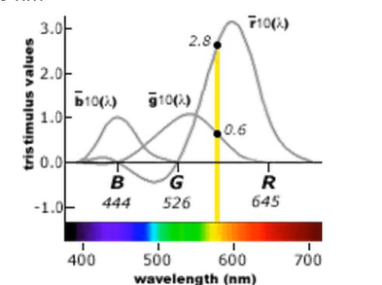
CIE 1931 XYZ
☆ Colors in the vicinity of 500 nm can be matched by subtracting an amount of red light from a combination of blue and green lights.
☆ Thus,RGB color monitor cannot display colors in the neighborhood of 500 nm.
☆ Problem solution:XYZ Color System
☆ Tristimulus system derived from RGB.
☆ Based 3 imaginary primaries.
☆ All 3 primaries are outside the human visual gamut.

Slide 8
CIE 1931 XYZ
☆ CIE is the International Commission on Illumination (Commission internationale de l’éclairage).
☆ The CIE color model is a mapping system that uses tristimulus (a combination of 3 color values that are close to red/green/blue) values, which are plotted on a 3D space.
☆ When these values are combined, they can reproduce any color that a human eye can perceive. The CIE specification is supposed to be able to accurately represent every single color the human eye can perceive.

Slide 9
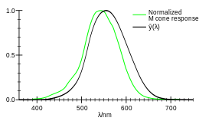
CIE 1931 XYZ
☆ X is a mix (a linear combination) of cone response curves chosen to be nonnegative
☆ Y as luminance.
☆ Z is quasi-equal to blue stimulation.
☆ XYZ tristimulus values are thus analogous to, but different from, the LMS cone responses of the human eye.
☆ Defining Y as luminance has the useful result that for any given Y value, the XZ plane will contain all possible chromaticities at that luminance.
*Comparison of typical M and CIE 1931.

Slide 10
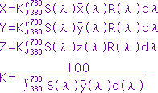
CIE 1931 XYZ
☆Tristimulus values determined based on the color matching functions:X’(λ),Y’(λ) and Z’(λ);also referred to as 2° XYZ tristimulus values.
Where;
S(λ): Relative spectral power distribution of the illuminant.
X’(λ),Y’(λ),Z’(λ):Color-matching functions for CIE 2° Standard Observer (1931).
R(λ): Spectral reflectance of specimen

Slide 11
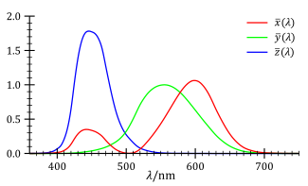
CIE 1931 XYZ
*The CIE standard observer color matching functions.

Slide 12
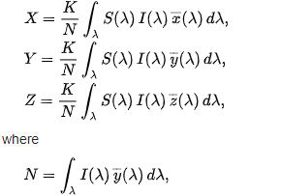
CIE 1931 XYZ
☆ The reflective and transmissive cases are very similar to the emissive case, with a few differences. The spectral radiance L_{e,Ω,λ} is replaced by the spectral reflectance (or transmittance) S(λ) of the object being measured, multiplied by the spectral power distribution of the illuminant I(λ).
*λ €[380,780]*

Slide 13
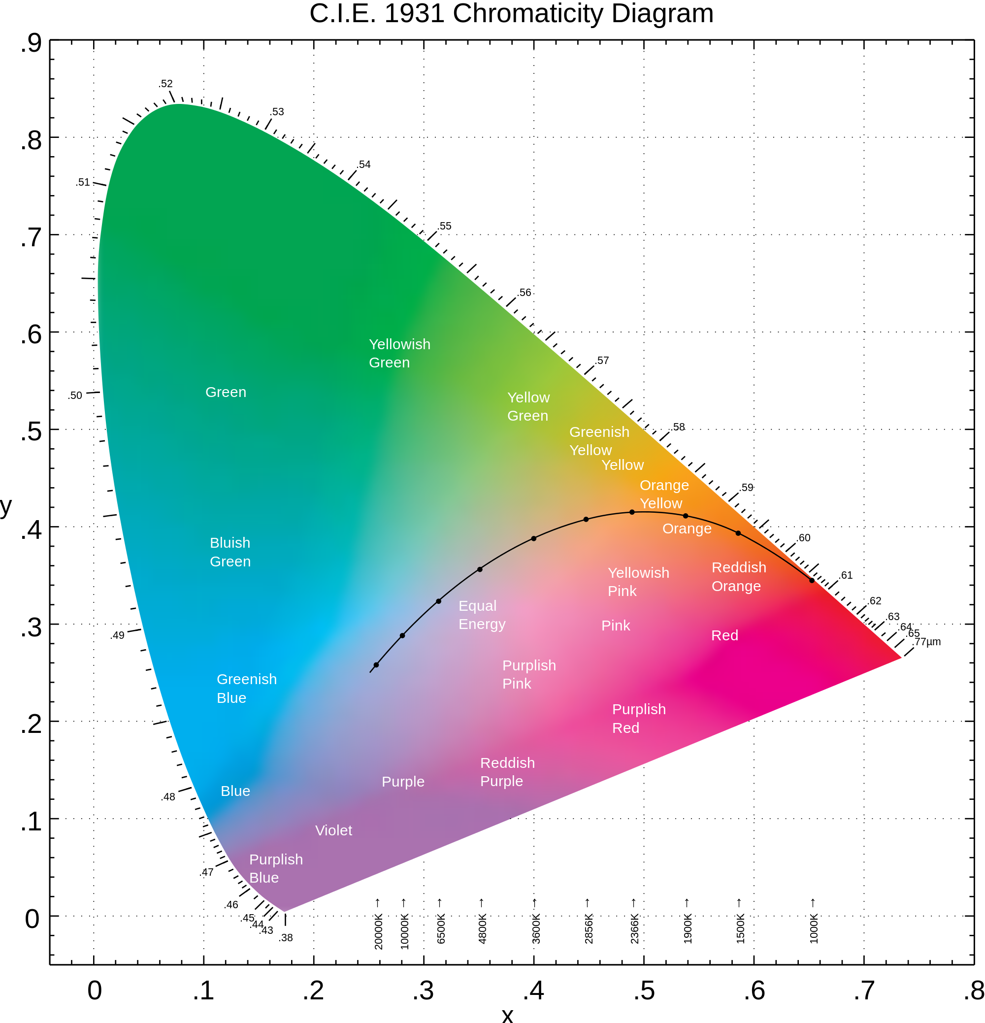
CIE 1931 XYZ
☆ The CIE system characterizes colors by a luminance parameter Y and two color coordinates x and y which specify the point on the chromaticity diagram.
☆ This system offers more precision in color measurement than do the Munsell and Ostwald systems.
☆ Because parameters are based on the spectral power distribution (SPD) of the light emitted from a colored object and are factored by sensitivity curves which have been measured for the human eye.

Slide 14
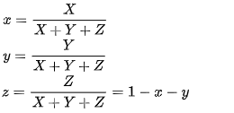

CIE 1931 XYZ
☆ The chromaticity of a color is then specified by the two derived parameters x and y, two of the three normalized values being functions of all three tristimulus values X, Y, and Z:
☆ The X and Z tristimulus values can be calculated back from the chromaticity values x and y and the Y tristimulus value:

Slide 15
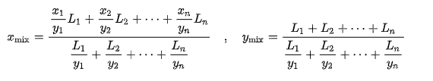

CIE 1931 XYZ
☆ When two or more colors are additively mixed, the x and y chromaticity coordinates of the resulting color (x_{mix},y_{mix}) may be calculated from the chromaticities of the mixture components (x₁,y₁; x₂,y₂; …; x_{n},y_{n}) and their corresponding luminances (L₁, L₂, …, L_{n}) with the following formulas:
☆ When two colors are mixed, the resulting color x_{mix},y_{mix} will lie on the straight line segment that connects these colors on the CIE xy chromaticity diagram. To calculate the mixing ratio of the component colors x₁,y₁ and x₂,y₂ that results in a certain x_{mix},y_{mix} on this line segment, one can use the formula

Slide 16


Transformation Of RGB/CIE 1931 XYZ
RGB to CIE 1931 XYZ:
CIE 1931 XYZ to RGB:

Slide 17
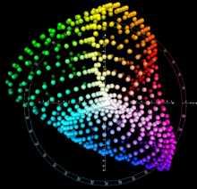
CIELAB
☆ CIE L*a*b* is a color model+space combo in which L is brightness and a and b are chrominance components.
☆ Color values are far more than the human gamut.
☆ This color space, also called Lab color space, also has imaginary colors that cannot be reproduced in the physical world
☆ Lab is neither RGB or CMYK, but a totally different color model.
☆ It is has a gamut that is greater than human vision.

Slide 18
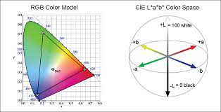
CIELAB
☆ The unique goal of the L*a*b* model is to be ‘device-independent’.
☆ The colors should not be dependent on the device they are displayed on.
☆ It is a purely theoretical color space that is used sometimes as an absolute standard to compare all other color spaces.
☆ Lab space is larger than the gamut of computer displays and printers.

Slide 19
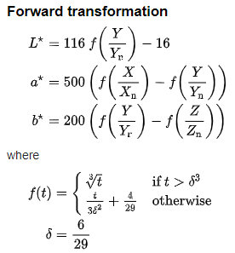
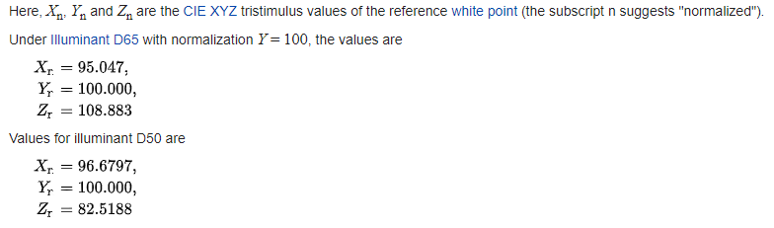
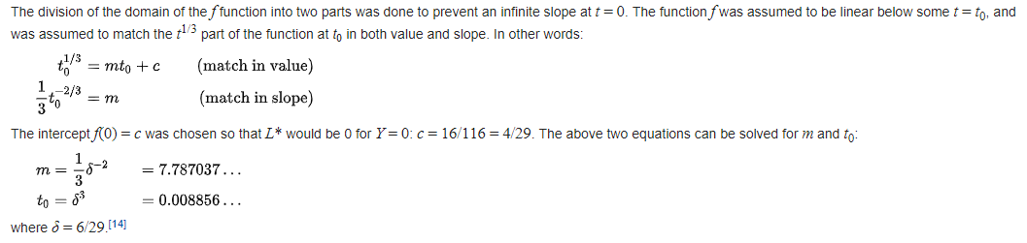
Transformation of CIELAB/RGB/XYZ
There are no simple formulas for conversion between RGB or CMYK values and L*a*b*, because the RGB and CMYK color models are device-dependent

Slide 20
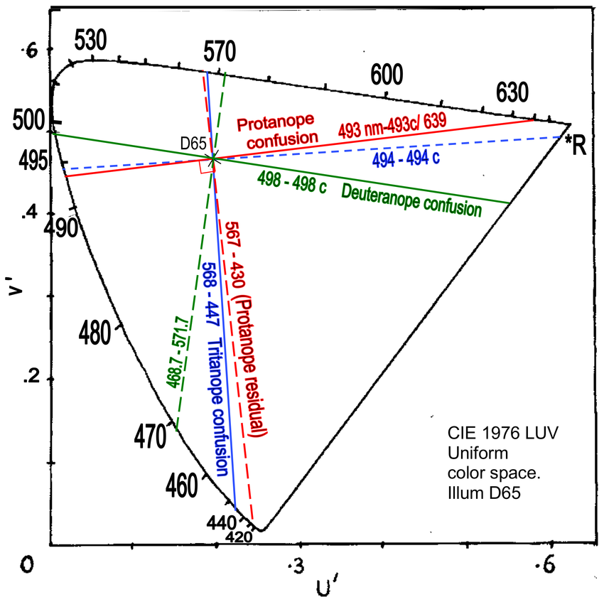
CIELUV
☆ This is based on CIE YUV (1976) and is a further attempt to linearise the perceptibility of unit vector color differences.
☆ It is a non-linear color space, but the conversions are reversible.
☆ Coloring information is centered on the color of the white point of the system, subscript n, (D65 in most TV systems).
☆ The non-linear relationship for Y* is intended to mimic the logarithmic response of the eye.

Slide 21
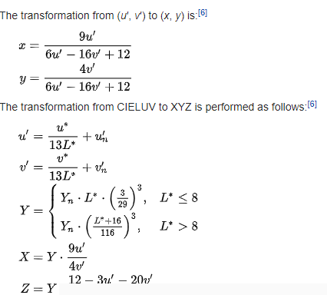
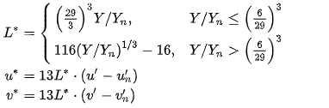
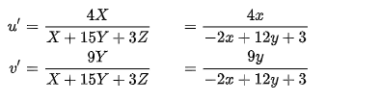
Transformation of CIELUV/XYZ

Slide 22
RGB Color spaces

Slide 23
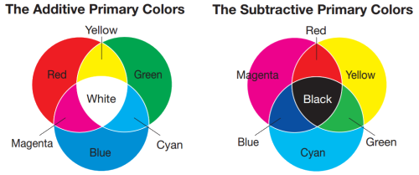
The two main color models based the concept of additive and substractive colors.
☆ Additive color models use light to display color
☆ Subtractive models use printing inks.

Slide 24
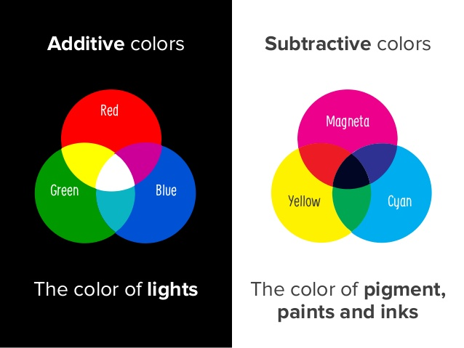

Slide 25
Types of RGB
☆ RGB
☆ sRGB
☆ Adobe RGB
☆ Adobe Wide Gamut RGB

Slide 26

☆Using for computer displays.
☆Uses light to display color.
☆Red+Green+Blue=White
☆Represent with 24-bits.
☆Additive colors

Slide 27
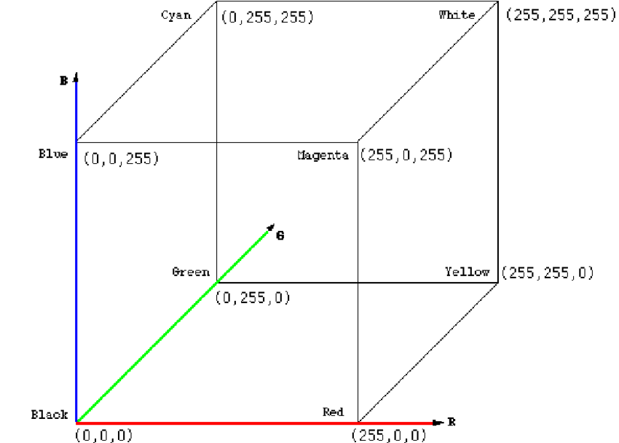
☆ Primary colors together can be represented as a three dimensional coordinate plane with the values for R (red), G (green) and B (blue) on each axis.

Slide 28
sRGB
☆sRGB stands for «Standard RGB»
☆Created by Microsoft and HP .
☆The sRGB color space is composed of a specific amount of color information.
☆This data is used to optimize and streamline colors between devices and technical platforms, such as computer screens, printers, and web browsers

Slide 29
Adobe RGB
☆Adobe RGB color space is an RGB color space developed by Adobe Systems. ☆ It was designed to encompass most of the colors achievable on CMYK color printers, but by using RGB primary colors on a device such as a computer display.
☆ The Adobe RGB (1998) color space encompasses roughly 50% of the visible colors specified by the CIELAB space– improving upon the gamut of the sRGB color space, primarily in cyan-green hues.

Slide 30
Adobe RGB wide gamut
☆That offers a large gamut by using pure spectral primary colors.
☆It is able to store a wider range of color values thab sRGB and Adobe RGB.
☆ When working in color spaces with such a large gamut, it is recommended to work in 16-bit per channel color depth to avoid posterization effects.
☆ This will occur more frequently in 8-bit per channel modes as the gradient steps are much larger.

Slide 31
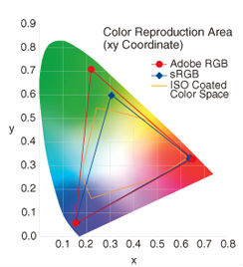

Slide 32
CMYK Color Spaces

Slide 33
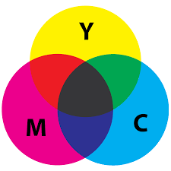
☆Subtractive color model
☆For printed material
☆Uses ink to display color
☆Colors result from reflected light
☆Cyan+Magenta+Yelllow=Black

Slide 34
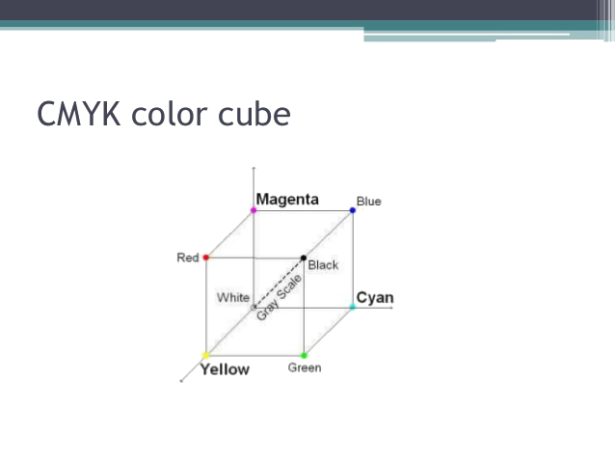
☆ The black is referred to as K denoting key, a shorthand for the printing term key plate.
☆ Unit cube defined on C,M,Y axes
☆ A printed color that looks red absorbs the other two components G and B reflects R.
☆ Thus the C-M-Y coordinates are just the complements of the R-G-B coordinates.

Slide 35
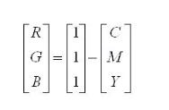
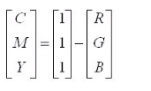
Transformation of RGB/CMYK

Slide 36
Luma+ Chroma/chrominance
☆ YIQ
☆ YUV
☆ YCbCr and YPbPr

Slide 37
YIQ(Luminance,Inphase,Quadrature)
☆ The YIQ color model is recoding of RGB color model.
☆ YIQ color model is used for TV broadcasting.
☆ Y-channel contains luminance information.(Black-white tv sets)
☆ I-Q channel contains color
İnformation.(chrominance)

Slide 38
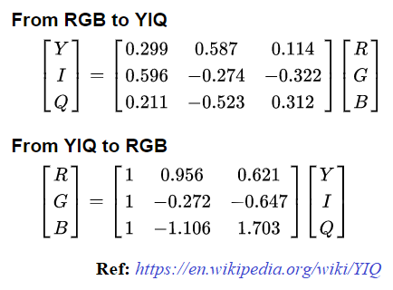
Transformation RGB/YIQ

Slide 39
YUV
☆ YUV color space is a bit unusual.
☆ The Y component determines the brightness of the color (referred to as luminance ).
☆ The U and V components determine the color itself (the chroma).
☆ Y ranges from 0 to 1 (or 0 to 255 in digital formats).
☆ U and V range from -0.5 to 0.5 (or -128 to 127 in signed digital form, or 0 to 255 in unsigned form). ☆ Since the human eye is more responsive to brightness than it is to color, many lossy image compression formats throw away half or more of the samples in the chroma channels to reduce the amount of data to deal with, without severely destroying the image quality.

Slide 40
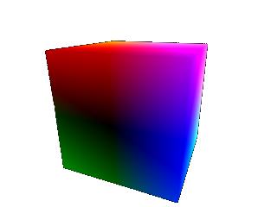
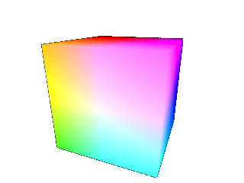
This image shows a slightly tilted representation of the YUV color cube, looking at the dark (Y = 0) side. Notice how in the middle it is completely black, which is where U and V are zero, and Y is as well. As U and V move towards their limits, you start to see their effect on the colors.
This image shows the same cube, from the bright side (Y = 1). Here we have bright white in the middle of the face, with very bright colors on the corners where U and V are also at their limits.

Slide 41
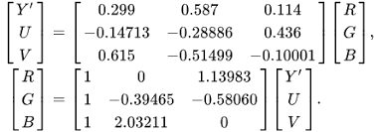
Transformation RGB/YUV

Slide 42

YCbCr
☆ YCbCr is a commonly used color space in digital video domain.
☆ YCbCr is a scaled and offset version of YUV.
☆ Exploits the properties of human eye.
☆Human eyes is more sensitive to chrominance.
☆ When in JPEG compression, it uses these sensitivities of the human eye.
☆MPEG compression,Camcorders

Slide 43
Luma in YCbCr
Luma is carried in the Y’ channel.
Eye is more sensitive to changes in luminance than to changes in chrominance.
Two color difference channels are encoded with less informaiton than Luma channel.
It called as subsampling.

Slide 44
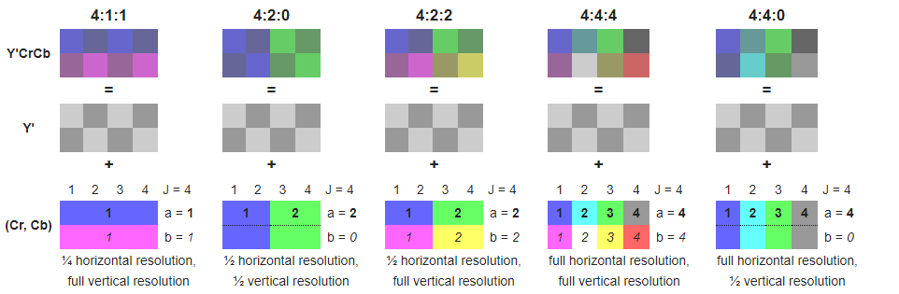
YCbCr

Slide 45
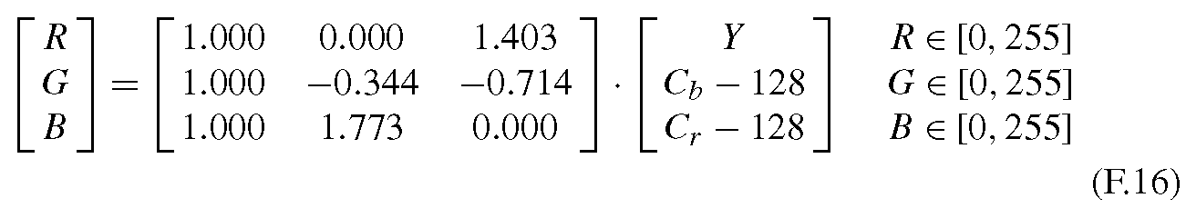
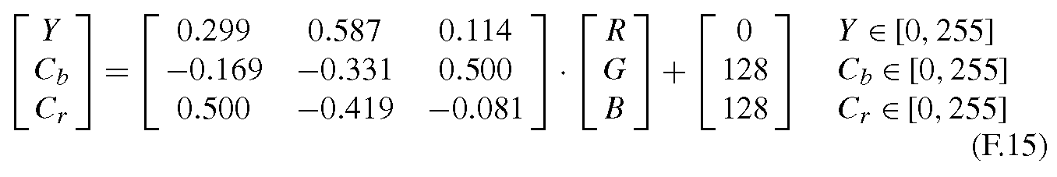
Transformation RGB/YCbCr

Slide 46
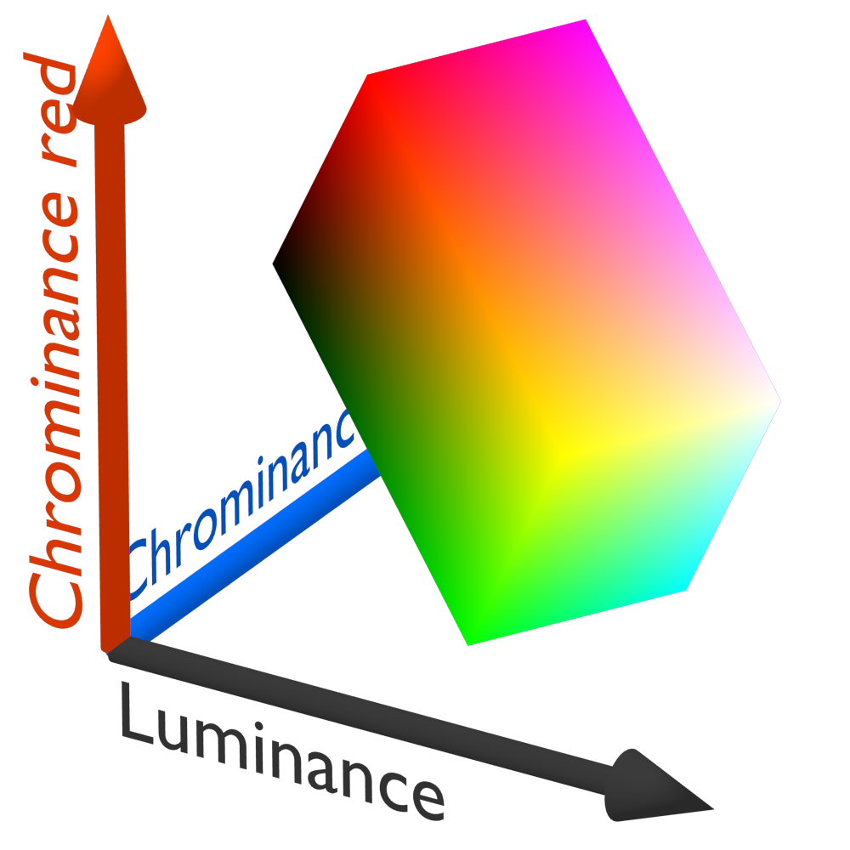

Slide 47
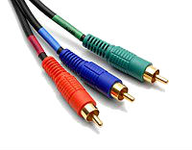

YPbPr
☆ Used in video electronics
☆ YPbPr is analog version of the YCbCr
☆ The two are numerically equivalent but YPbPr is designed for use in analog systems while YCbCr is intended for digital video.
☆Used in TV,DVD Players,cable boxes,receivers...etc.

Slide 48
Cylindirical Transformatıon
☆HSV
☆HSL

Slide 49
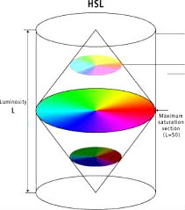
HSL
☆Hue,Saturation and Lightness
☆Most commonly used cylindirical coordinate system for representing RGB.
☆Developed in 1970 for computer graphics applications,color pickings and image editing softwares.

Slide 50
HSL
☆ Hue:The angle around the central vertical axis
☆ Saturation:The distance from the central axis
☆ Lightness:The distance along the central axis

Slide 51
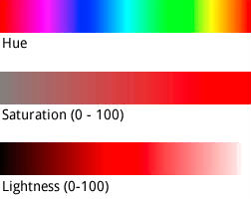
HSL Color Attributes
☆ Hue:It refers to pure spectrum of colours without tint or shade.
☆ Saturation:The "colorfulness of a stimulus relative to its own brightness«.
☆ Lightness:The "brightness relative to the brightness of a similarly illuminated white"

Slide 52
HSL Scale
☆ Hue is represented as angle of colour circle,given as unit less number.
Red=0=360,
Green=240,
Blue=360
☆ Saturation and Luminosity is represented as percentage:
100% Full Saturation
0% Shade of grey
100% Luminosity is white
0% Luminosity is black

Slide 53
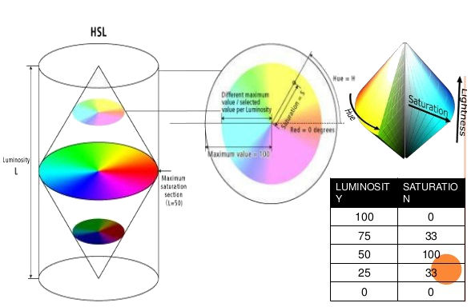
HSL Representation

Slide 54
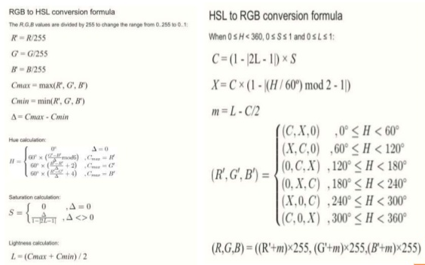
Transformation RGB/HSL

Slide 55
HSV
☆HSV stands for Hue,Saturation and Value
☆Used for generate high quality computer graphics,select desired color or etc.
☆Used in color pickers,image editing software,image analysis and computer vision
☆Most common cylindirical coordinate representation of RGB model
☆Describes color in terms of their shade and brightness.

Slide 56
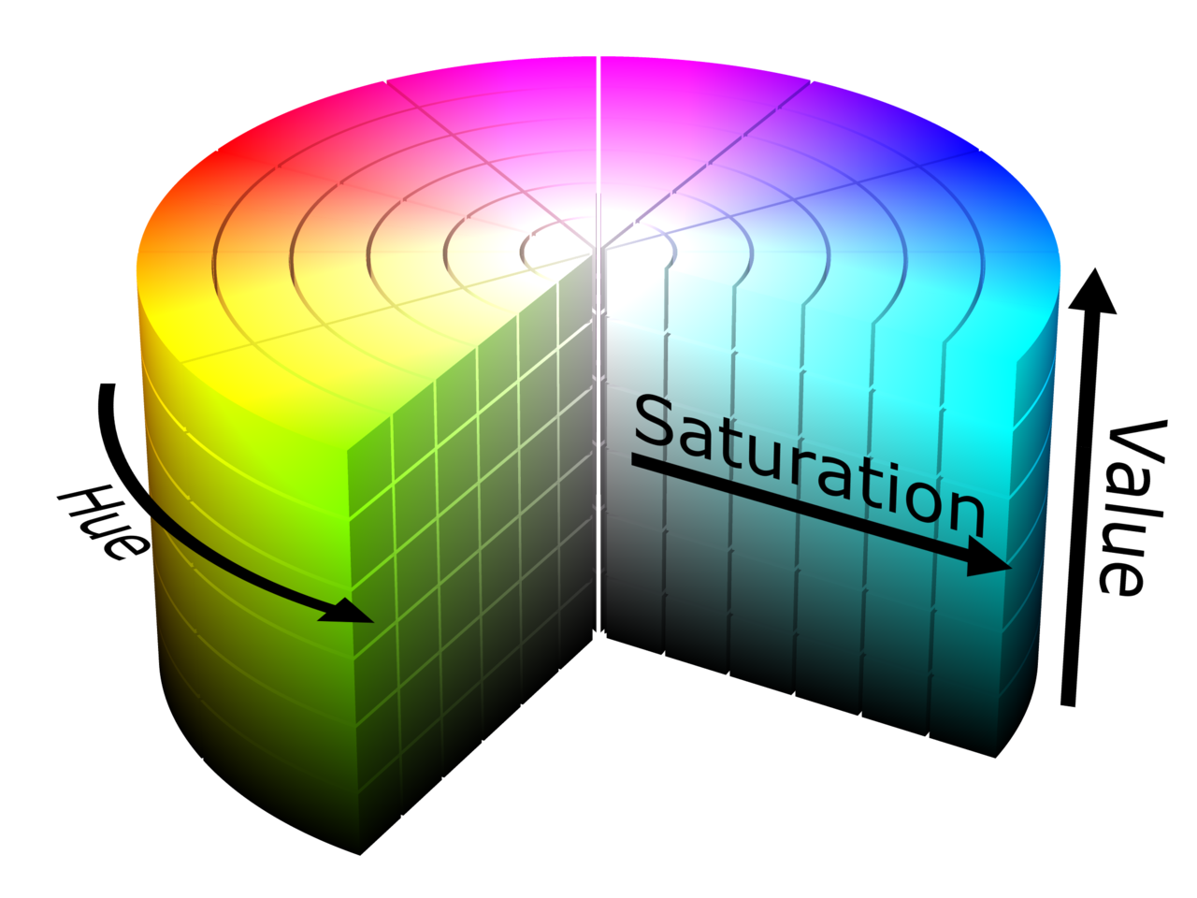
HSV
☆ Hue,Saturation,Value
☆ Hue(H):Color portion of the color model, expressed as a number from 0 to 360 degrees.
☆ Saturation(S):is the amount of gray in the color, from 0 to 100 percent.
☆ Value(V or brightness):Value works in conjunction with saturation and describes the brightness or intensity of the color, from 0–100 percent, where 0 is completely black, and 100 is the brightest and reveals the most color.

Slide 57
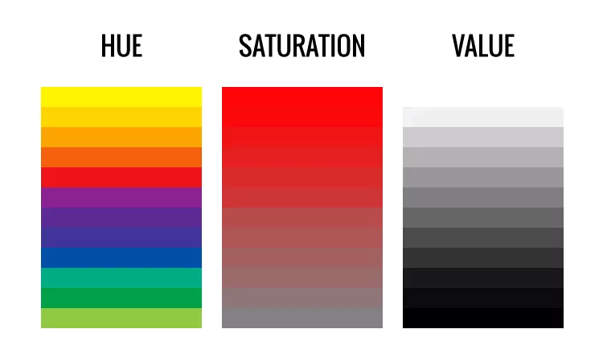
HSV

Slide 58
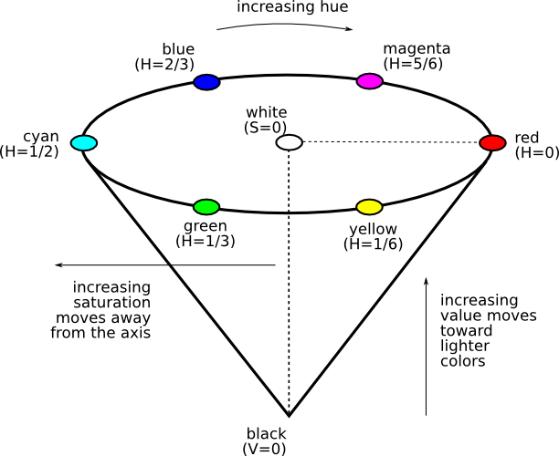
HSV

Slide 59
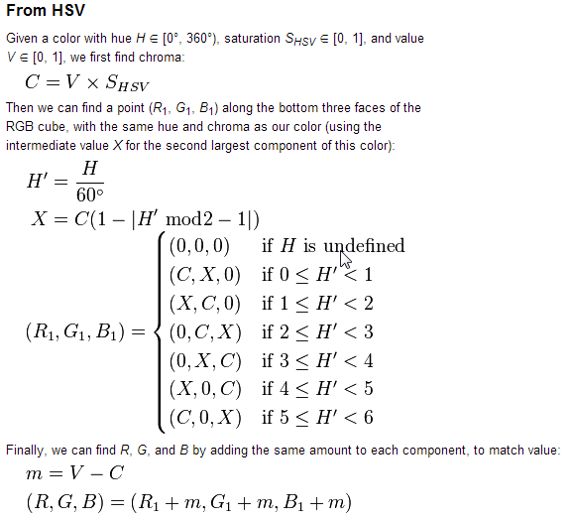
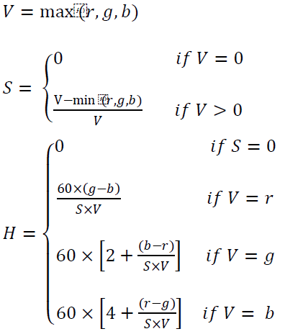
Transformation RGB/HSV
RGB to HSV:

